Slide 1

A Unified Anomaly Synthesis Strategy with Gradient Ascent for Industrial Anomaly Detection and Localization
Paper review
Gibeom Kim (UST)

Slide 2

Index
Paper abstract
Model
Conclusion

Slide 3
1. Paper abstract
GLASS is proposed for detecting weak defect
Global Anomaly Synthesis (GAS) at the feature level
Local Anomaly Synthesis (LAS) at the image level
Use these two synthesis strategy to address weak defect
Trains on this wide range of synthetic anomalies to achieve SOTA results on MVTec AD, VisA, MPDD benchmark

Slide 4
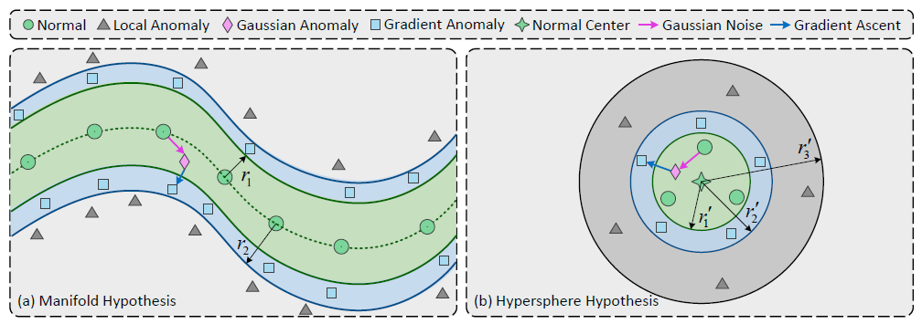
2. Model
Manifold Hypothesis
Hypersphere Hypothesis
Notes:
In low dimensions, the normal feature can be represented in Euclidean space as linear combinations, as shown in the figure on the left, representing the overall nonlinear distribution.
It also assume that the combination of normal feature points is contained inside a single compact circle, as shown in the figure on the right.

Slide 5
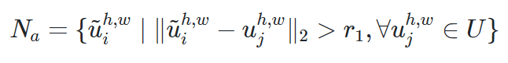
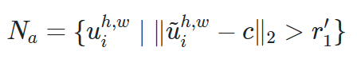
2. Model

Slide 6
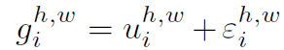
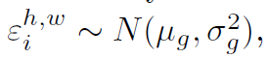
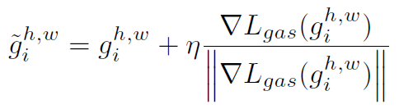
2. Model
Notes:
무작정 노이즈를 더하는 Gaussian anomaly 단계
그 노이즈 벡터를 출발점 삼아,
손실을 최대화하는 방향(∇L_{gas})으로
일정한 크기(η)만큼 이동(=gradient ascent)

Slide 7
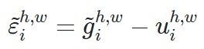
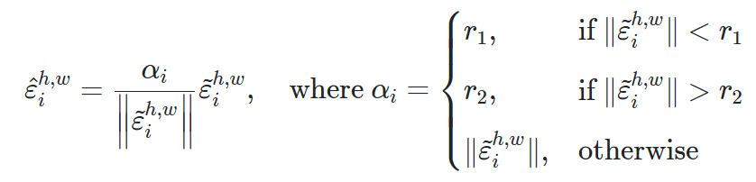
2. Model
Truncated Projection

Slide 8
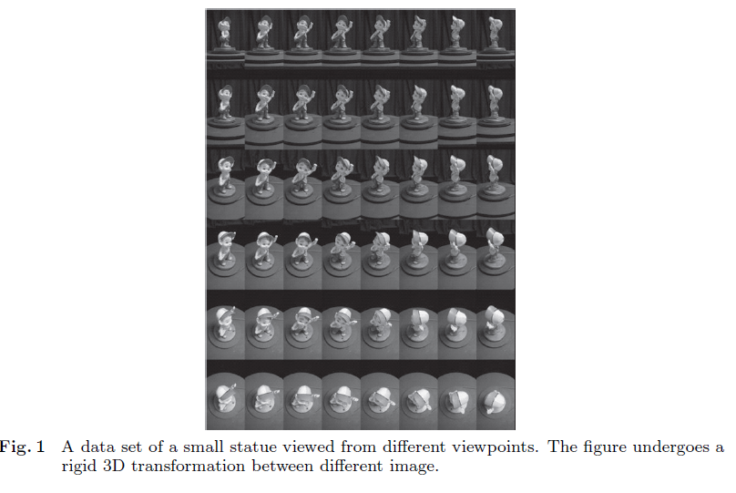
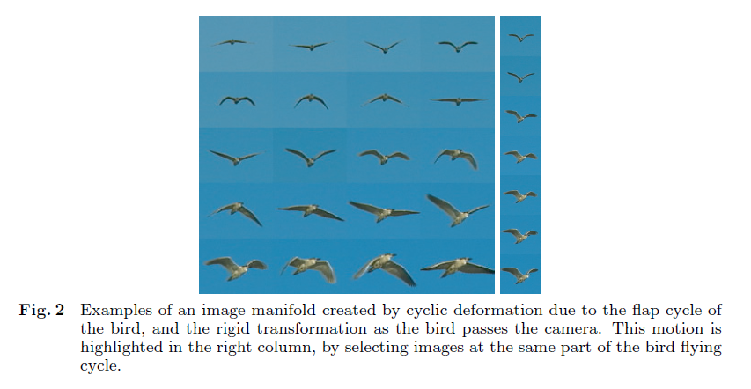
2. Model
Manifold learning
How to learn from the assumption that if sprinkle high-dimensional data into a data space, there will be a subspace that covers the samples well.
Notes:
complex image change is actually described by a small number of generating factors, and knowing their dimensions and topology (planar vs. cylindrical)
We can use manifold learning to unfold the structure for use in pose estimation, motion analysis, and more.

Slide 9
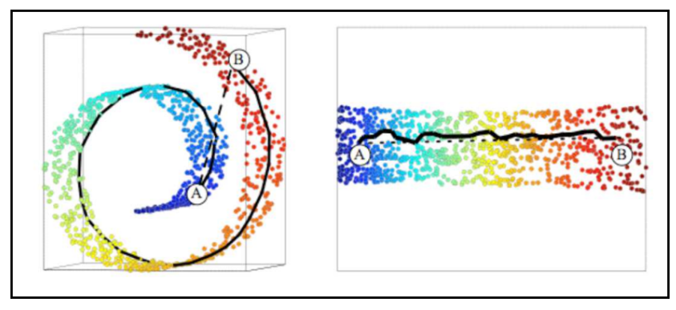
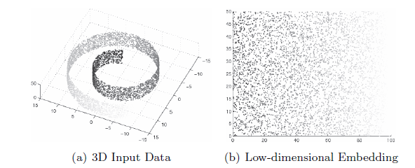
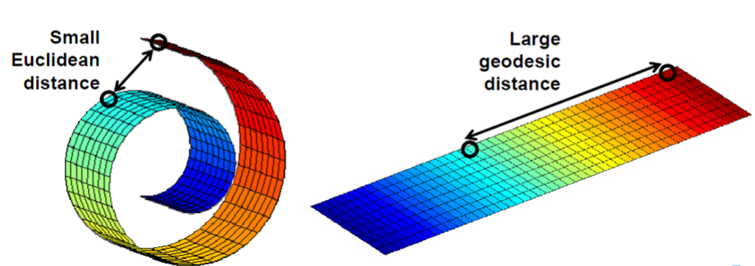
2. Model
Manifold learning
ISOMAP
Notes:
Swiss roll dataset

Slide 10
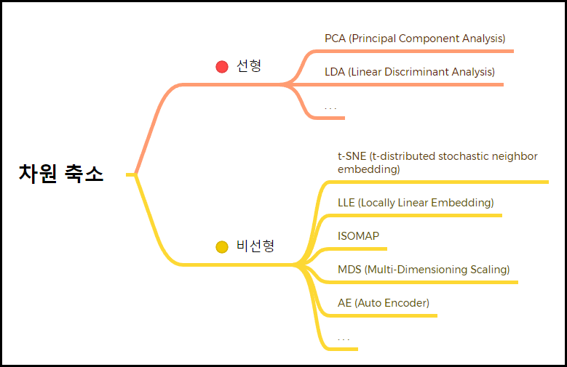
2. Model
Manifold learning
Linear
Dimension reduction
Non-Linear

Slide 11
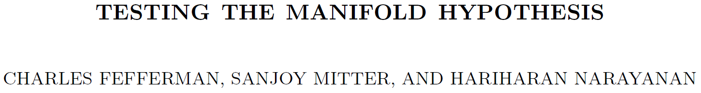
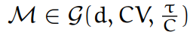
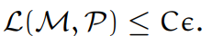
2. Model
Manifold learning
Given parameters such as a target dimension d, a volume upper bound V, a smoothness (reach) τ, and an error tolerance ε, determine whether the data distribution 𝒫 is concentrated near a low-dimensional manifold 𝓜 that satisfies these conditions.

Slide 12
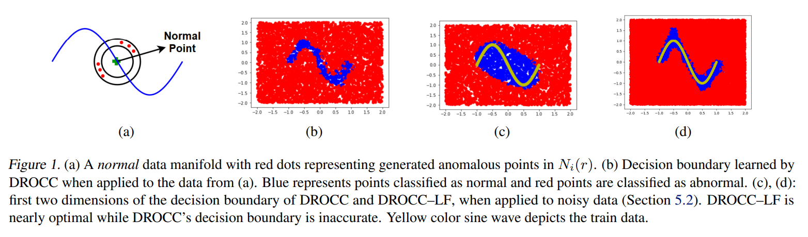
2. Model

Slide 13
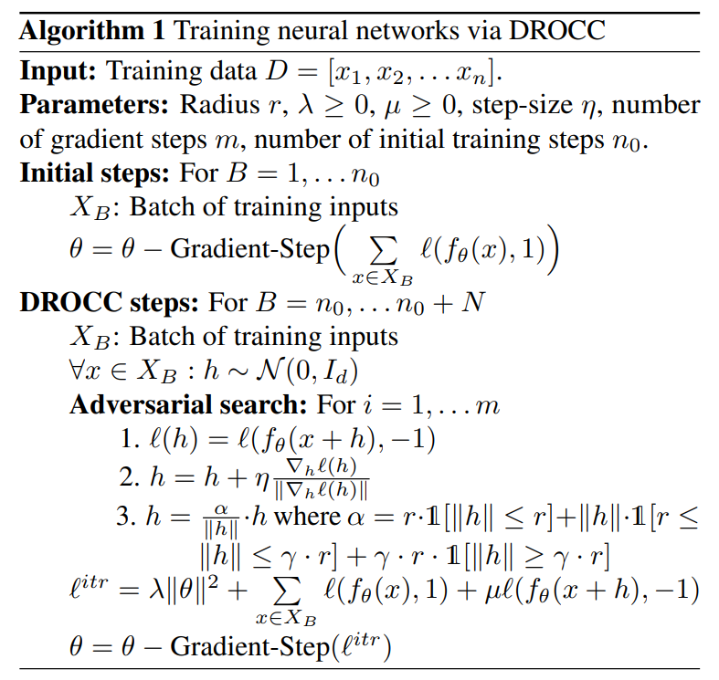
2. Model
Notes:
세타는 모델 파라미터
l_^iter 첫항은 l2 regularization 2항은 정상이미지의 손실값 3항은 합성 이미지의 손실값, 뮤는 이상 손실 가중치로 정상 및 이상 데이터의 중요도를 결정

Slide 14
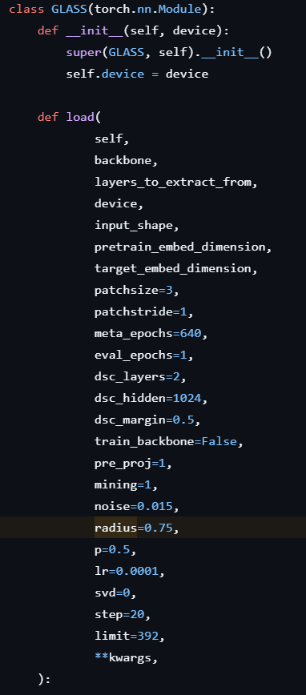
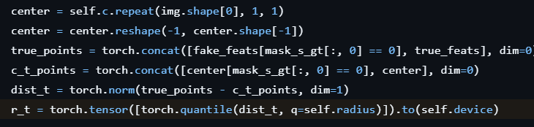
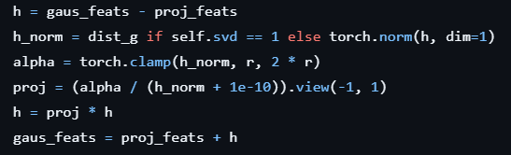
2. Model
Notes:
정상-센터 거리 분포 구하기
r(= r_min) 계산 상위 75 % 지점이 r_t
가우시안 + Gradient-Ascent 특징을 r~2 r 로 투영

Slide 15
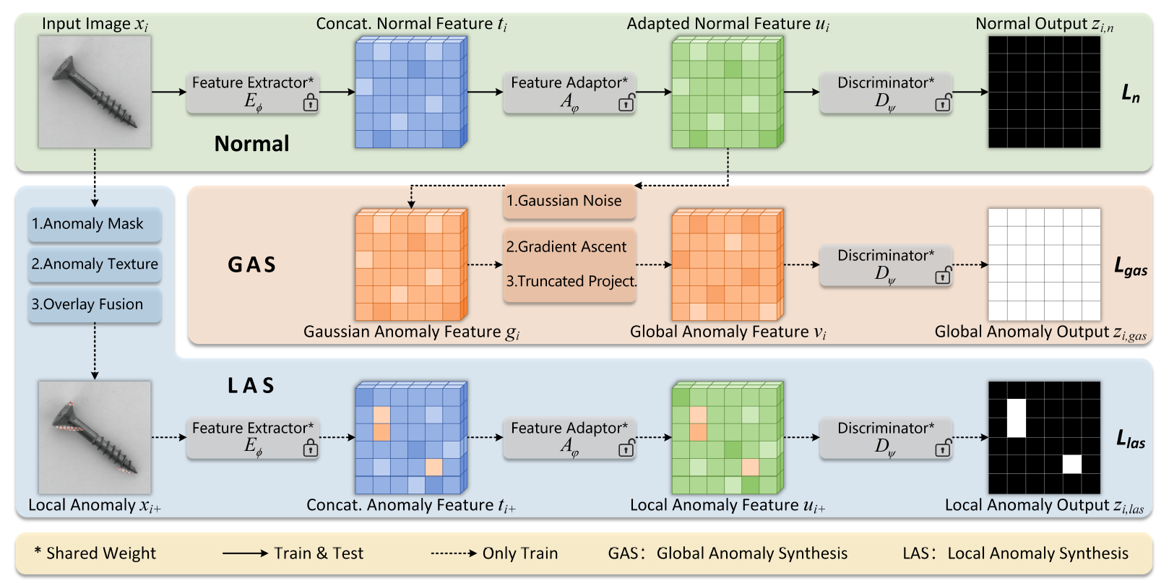
2. Model

Slide 16
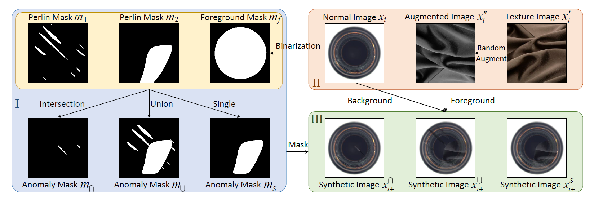
2. Model
Notes:
Step I:Anomaly Mask, Step II: Anomaly Texture, and Step III: Overlay Fusion.

Slide 17
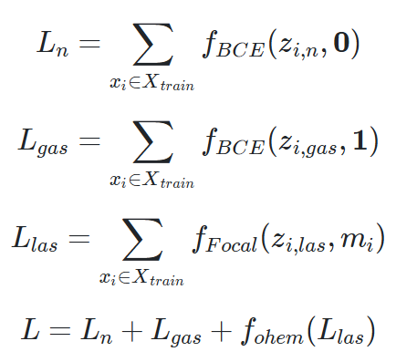
2. Model
BCE to L_n and L_gas
Focal loss to L_las
Sum all of losses to make total loss L
Notes:
For a Normal image, 0 is the correct answer mask for all pixels because there are no bad pixels.
GAS applies Gaussian noise and gradient multiplication over the entire range, so all pixels are bad, so 1 is the answer mask.
LAS puts the anomaly mask as the correct answer mask because the only bad pixels are where the anomaly mask is applied.

Slide 18
3. Conclusion
Integrates image-level (LAS) and feature-level (GAS) synthesis to cover anomalies from “weak” to “strong.”
Employs gradient-ascent-based Global Anomaly Synthesis to effectively generate subtle defects near the normal data boundary.
Achieves state-of-the-art results on MVTec AD, VisA, MPDD benchmarks and demonstrates real-world applicability.

Slide 19
Thank you

